Slide 1

Binary search algorithm
-- #greenlearner --

Slide 2
Binary search
Input
Data set which should be in sorted order
Target element to find in the data set -
Steps to be performed to get the result
Find the mid of the data set
If target is equal to mid element return the index
Else
If target < mid element then ignore the right hand side of the mid element of data set
Repeat the first step with left side of data set
Else ignore the left side of the data set
Repeat the first step with right side of data set
34 | 45 | 55 | 65 | 78 | 90 | 234 | 321 | 456 | 789
45

Slide 3
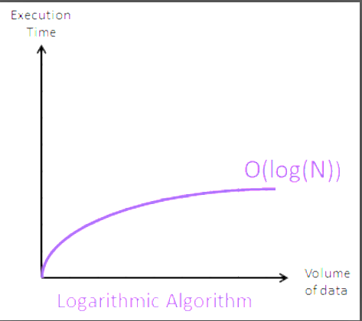
Performance analysis
Time complexity
Worst case - O(log n)
Average case – O(1)
Best case – O(log n)
Space complexity
Worst case – O(1)

Slide 4
Next
Sorting algorithms..

Slide 5
Thanks a lot for your time !!

